Slide 1



Fast Tag Fraud Analysis
Understanding the Impact of Various Factors
Yassine Marrekchi
Business Analytics Student
@Tunis-Business-School
June 2024

Slide 2

Introduction
What is Fast Tag Fraud
Fast tag fraud refers to the illegal manipulation or misuse of electronic toll collection systems, where unauthorized users exploit weaknesses to avoid paying toll fees. This can involve cloning legitimate fast tags, using fake tags, or tampering with the toll system..
Types of frauds
Cloning: Cloning involves creating duplicate copies of legitimate fast tags to evade toll payments fraudulently.
Misuse of Tags: Misuse of tags occurs when fast tags are used on unauthorized or multiple vehicles to bypass toll fees.
Manipulation of Data: Manipulation of data refers to altering transaction records or system data to conceal toll evasion or unauthorized use

Slide 3
Methodology
Data collection from different sources
Analytical tools used : Python
Fraud detection techniques : different machine learning models ( Logistic Regression , Decision Tree , Random Forest , Extreme Gradient Boost )
+
+
+

Slide 4
Data Analysis
& Techniques used
Logistic Regression
Machine Learning methods used to analyze salary data
Key findings and trends
Pre-processing and transforming data
Predicts binary outcomes using probabilities.
Models the probability that a given input belongs to a particular class.
Uses the logistic function to constrain the output between 0 and 1.
Suitable for binary classification tasks.
Predicted proportion of employess with salaries above / below the mean
Decision Tree
Random Forest
XGBoost
Splits data into decision nodes.
Constructs a tree where each node represents a decision based on an attribute.
Capable of capturing non-linear relationships.
Prone to overfitting if not properly tuned.
Provides an intuitive model that's easy to interpret.
Gradient boosting with regularization techniques.
Combines the predictions of multiple weak learners (trees) to form a strong learner.
Uses a gradient descent algorithm to minimize errors.
Regularization helps prevent overfitting and improves generalization.
Highly efficient and scalable, suitable for large datasets.
Ensemble of multiple decision trees.
Combines predictions from several trees to improve accuracy.
Reduces overfitting compared to a single decision tree.
Handles both regression and classification tasks.
Robust against noise and capable of handling large datasets.

Slide 5
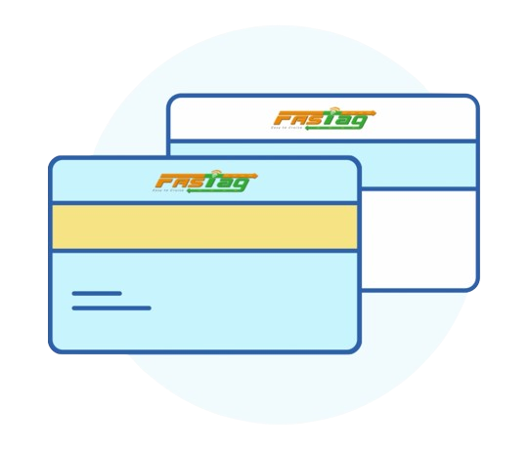
Analysis And Findings
KEY FINDINGS
Frequency of fraud incidents
Common Patterns
High-Risk Zones

Slide 6
Recommendations
i
Based on our findings, we propose several countermeasures to combat Fast Tag Fraud:
Enhanced Security Protocols: Implementing stronger encryption and security measures for Fast Tags can reduce the risk of cloning and data manipulation.
Regular Audits: Conducting regular audits of toll transactions and tag usage can help detect and address fraudulent activities promptly.
Public Awareness Campaigns: Educating the public about the consequences of Fast Tag Fraud and encouraging reporting of suspicious activities can enhance the overall security of the toll collection system."

Slide 7
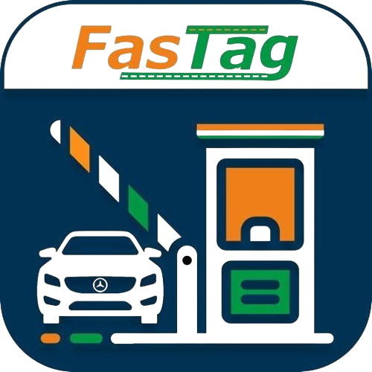
Conclusion
In conclusion, Fast Tag Fraud poses a significant challenge to toll collection systems, but with targeted strategies, it is possible to mitigate its impact. Our study provides valuable insights into the nature of these fraudulent activities and offers practical recommendations to enhance system integrity and security.

